Slide 1


Noman Shaikh
28-06-25

Slide 2

Outline
Executive Summary
Introduction
Methodology
Results
Conclusion
Appendix

Slide 3
Executive Summary
This capstone project focuses on predicting the successful landing of the SpaceX Falcon 9 first-stage booster by applying a range of machine learning classification techniques.
The workflow for the project included:
Gathering and preparing the data
Performing exploratory analysis to uncover patterns
Creating interactive visualizations for deeper insights
Building and evaluating predictive models
Through our analysis, we identified several features—such as launch site, booster version, and payload mass—that influence the likelihood of a successful landing. Among the models tested, the Decision Tree algorithm emerged as a strong candidate, offering the most reliable predictions for Falcon 9 first-stage landing outcomes.

Slide 4
Introduction
In this capstone project, our objective is to predict whether the Falcon 9 first-stage booster will land successfully. SpaceX offers Falcon 9 launches at a competitive price of $62 million, compared to over $165 million charged by other providers. A key reason for this cost advantage lies in SpaceX’s ability to recover and reuse the rocket’s first stage. Therefore, being able to anticipate the landing success can provide valuable insight into potential cost savings per launch.
This predictive capability can be particularly useful for other companies aiming to compete with SpaceX, allowing them to estimate launch costs more accurately and tailor their bids accordingly.
It’s important to note that not all failed landings are accidents—some are intentionally controlled landings in the ocean, carried out as part of mission strategy.
The core question we aim to answer is: Given various launch features—such as payload mass, orbit type, launch site, and booster version—can we accurately predict whether the first stage of a Falcon 9 rocket will land successfully?

Slide 5

Section 1

Slide 6
Methodology
The project follows a comprehensive workflow consisting of the following phases:
Data Acquisition and Preparation
Collected data through the SpaceX API and web scraping
Performed data cleaning, wrangling, and formatting to prepare it for analysis
Exploratory Data Analysis (EDA)
Utilized Pandas and NumPy for statistical exploration and feature understanding
Executed SQL queries to extract and analyze structured information
Data Visualization
Created static and comparative plots using Matplotlib and Seaborn
Built an interactive map with Folium
Developed dynamic dashboards with Dash for deeper insight
Predictive Modeling
Applied various machine learning classification algorithms:
Logistic Regression
Support Vector Machine (SVM)
Decision Tree
K-Nearest Neighbors (KNN)

Slide 7
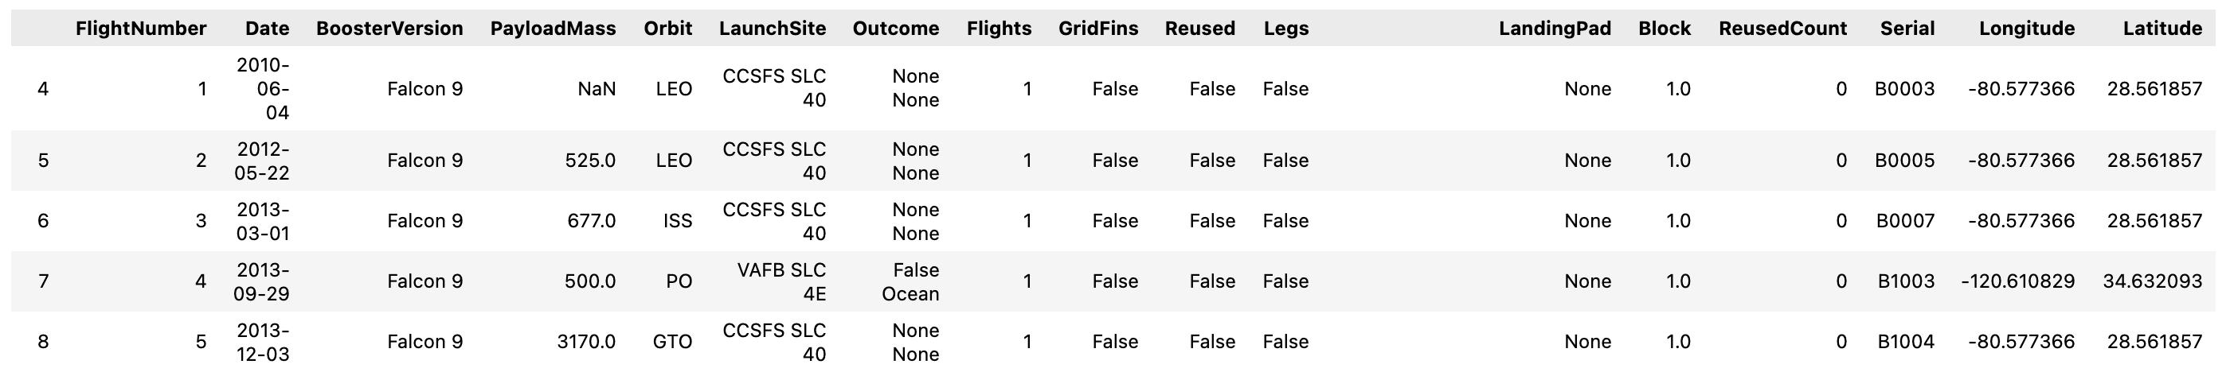
Data Collection Wrangling & Formatting
SpaceX API
The API used is https://api.spacexdata.com/v4/rockets/.
The API provides data about many types of rocket launches done by SpaceX, the data is therefore filtered to include only Falcon 9 launches.
Every missing value in the data is replaced the mean the column that the missing value belongs to.
We end up with 90 rows or instances and 17 columns or features. The picture below shows the first few rows of the data:

Slide 8

Web Scraping
To supplement our dataset, we performed web scraping on the following Wikipedia page: List of Falcon 9 and Falcon Heavy launches
This page provides detailed information specifically about Falcon 9 launches. After extracting and cleaning the data, we obtained a dataset consisting of 121 records (launch instances) and 11 features. These features include details such as launch date, mission outcome, booster version, payload, and more.
Below is a preview of the first few rows of the cleaned dataset:

Slide 9
Data Collection - Scraping
The scraped data was further processed to ensure consistency and usability for machine learning. This included handling missing values and applying one-hot encoding to transform categorical features into numerical format.
An additional column named ‘Class’ was introduced to represent the landing outcome of each launch:
1 indicates a successful landing
0 indicates a failed landing
After cleaning and encoding, the final dataset consisted of 90 rows (instances) and 83 columns (features), ready for exploratory analysis and predictive modeling.

Slide 10
Data Collection Wrangling & Formatting
Describe how data were processed
You need to present your data wrangling process using key phrases and flowcharts
Add the GitHub URL of your completed data wrangling related notebooks, as an external reference and peer-review purpose

Slide 11
EDA with Data Visualization
Data Exploration with Pandas and NumPy
We utilized functions from the Pandas and NumPy libraries to perform basic exploratory data analysis. Key insights derived include:
The number of launches per launch site
The frequency of each orbit type
The count and distribution of mission outcomes
These operations helped us understand the structure and composition of the dataset before applying more complex analysis.

Slide 12
EDA with SQL
Data Querying with SQL
To answer specific analytical questions, we used SQL queries on the dataset. Some of the queries included:
Retrieving the unique names of launch sites used in the missions
Calculating the total payload mass carried by boosters launched under NASA's CRS program
Determining the average payload mass delivered by booster version F9 v1.1
These queries provided deeper insights into the dataset and helped support feature selection for our machine learning models.

Slide 13

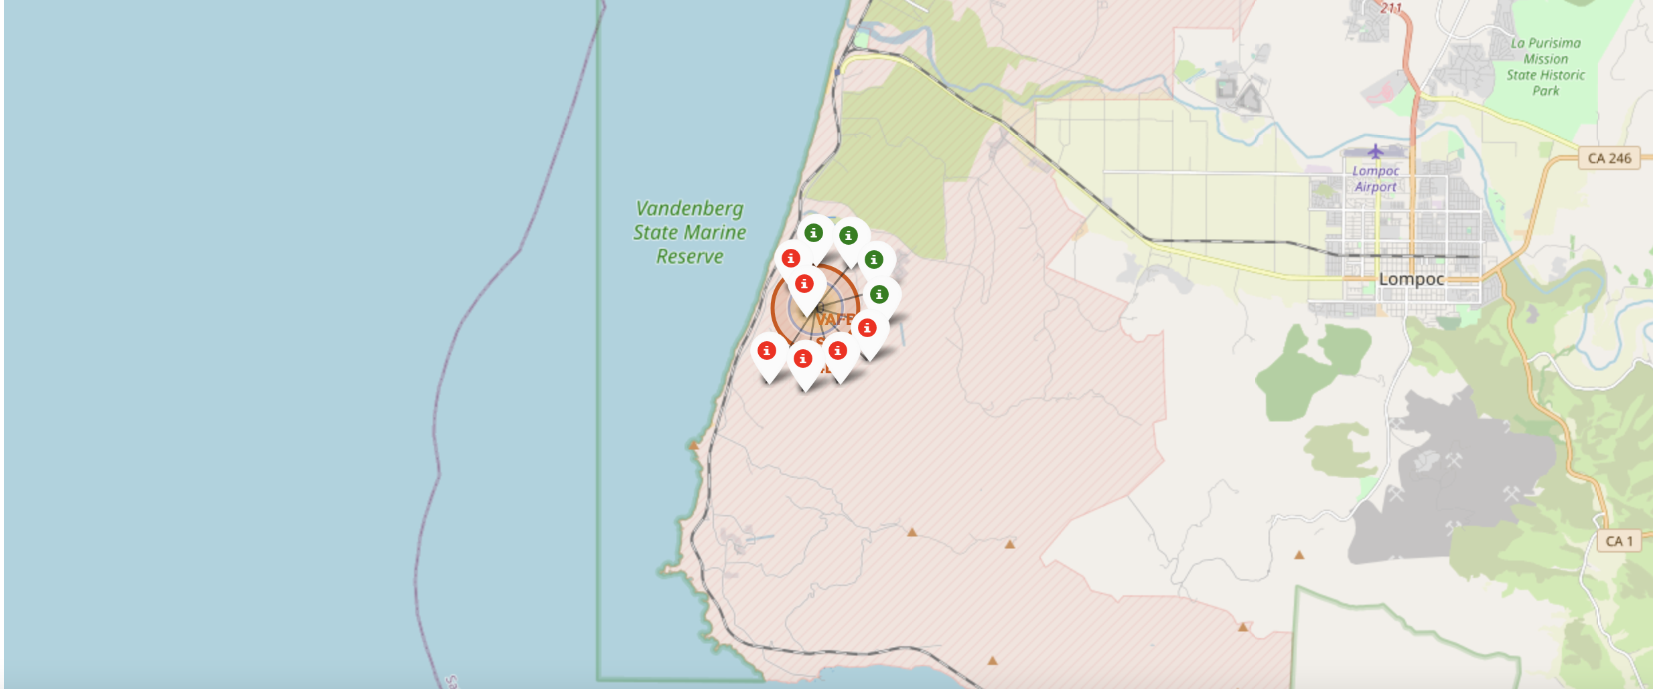
Build an Interactive Map with Folium
All launch sites on map
The succeeded launches and failed launches for each site on map
If we zoom in on one of the launch site, we can see green and red tags. Each green tag represents a successful launch while each red tag represents a failed launch

Slide 14
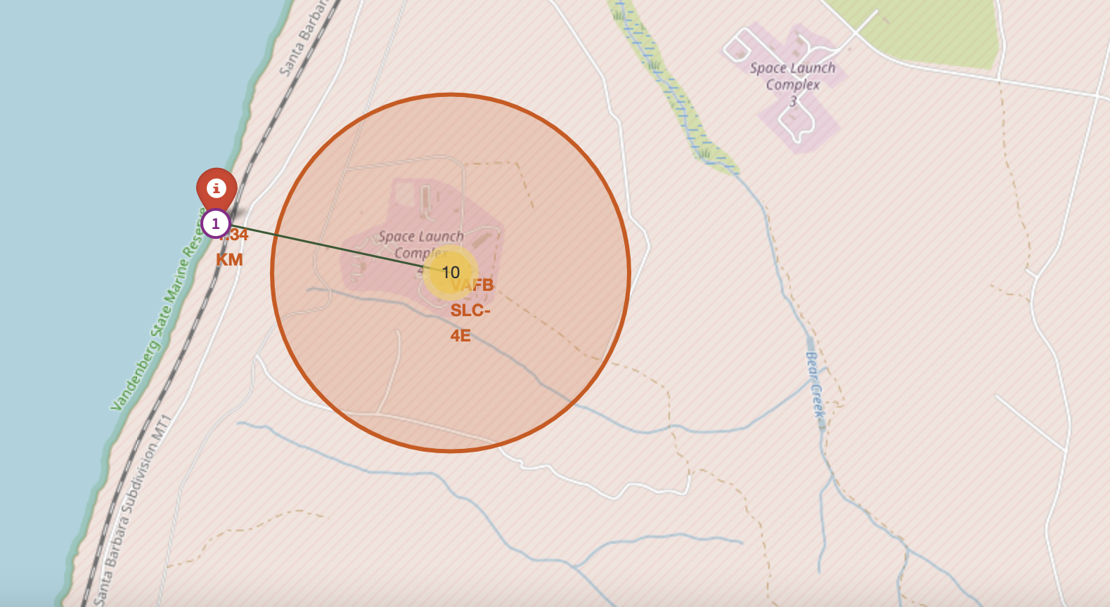
Results Folium
The distances between a launch site to its proximities such as the nearest city, railway, or highway
The picture below shows the distance between the VAFB SLC-4E launch site and the nearest coastline

Slide 15
Build a Dashboard with Plotly Dash
Summarize what plots/graphs and interactions you have added to a dashboard
Explain why you added those plots and interactions
Add the GitHub URL of your completed Plotly Dash lab, as an external reference and peer-review purpose

Slide 16
Build a Dashboard with Plotly Dash
Dash
Functions from Dash are used to generate an interactive site where we can toggle the input using a dropdown menu and a range slider.
Using a pie chart and a scatterplot, the interactive site shows:
The total success launches from each launch site
The correlation between payload mass and mission outcome (success or failure) for each launch site

Slide 17
Predictive Analysis (Classification)
Machine Learning Prediction
We used the Scikit-learn library to build and evaluate various machine learning classification models. The prediction workflow followed these key steps:
Data Standardization
Features were scaled to ensure consistent ranges, improving model performance and convergence.
Data Splitting
The dataset was divided into training and testing subsets to evaluate model generalization.
Model Development
The following classification algorithms were implemented:
Logistic Regression
Support Vector Machine (SVM)
Decision Tree
K-Nearest Neighbors (KNN)
Model Training
Each model was trained using the training data and fitted to learn the patterns in the features.
Hyperparameter Tuning
We explored different combinations of hyperparameters to optimize each model’s performance.
Model Evaluation
Models were assessed using accuracy scores and confusion matrices to compare their predictive capabilities.

Slide 18
Results
Results Overview
The project results are presented across five main sections, each highlighting different aspects of the analysis and insights:
SQL – Exploratory Data Analysis (EDA with SQL)
Extracted meaningful insights using SQL queries on the structured dataset.
Matplotlib and Seaborn – EDA with Visualizations
Visualized trends, correlations, and distributions to better understand the data.
Folium – Interactive Mapping
Created geographic visualizations to explore launch site locations and outcomes.
Dash – Interactive Dashboard
Developed an interactive web-based dashboard for dynamic data exploration and storytelling.
Predictive Analysis
Built and evaluated machine learning models to predict launch success based on input features.
In all visualizations and analyses, Class 0 indicates a failed launch, while Class 1 indicates a successful landing of the Falcon 9 first stage.

Slide 19

Section 2

Slide 20
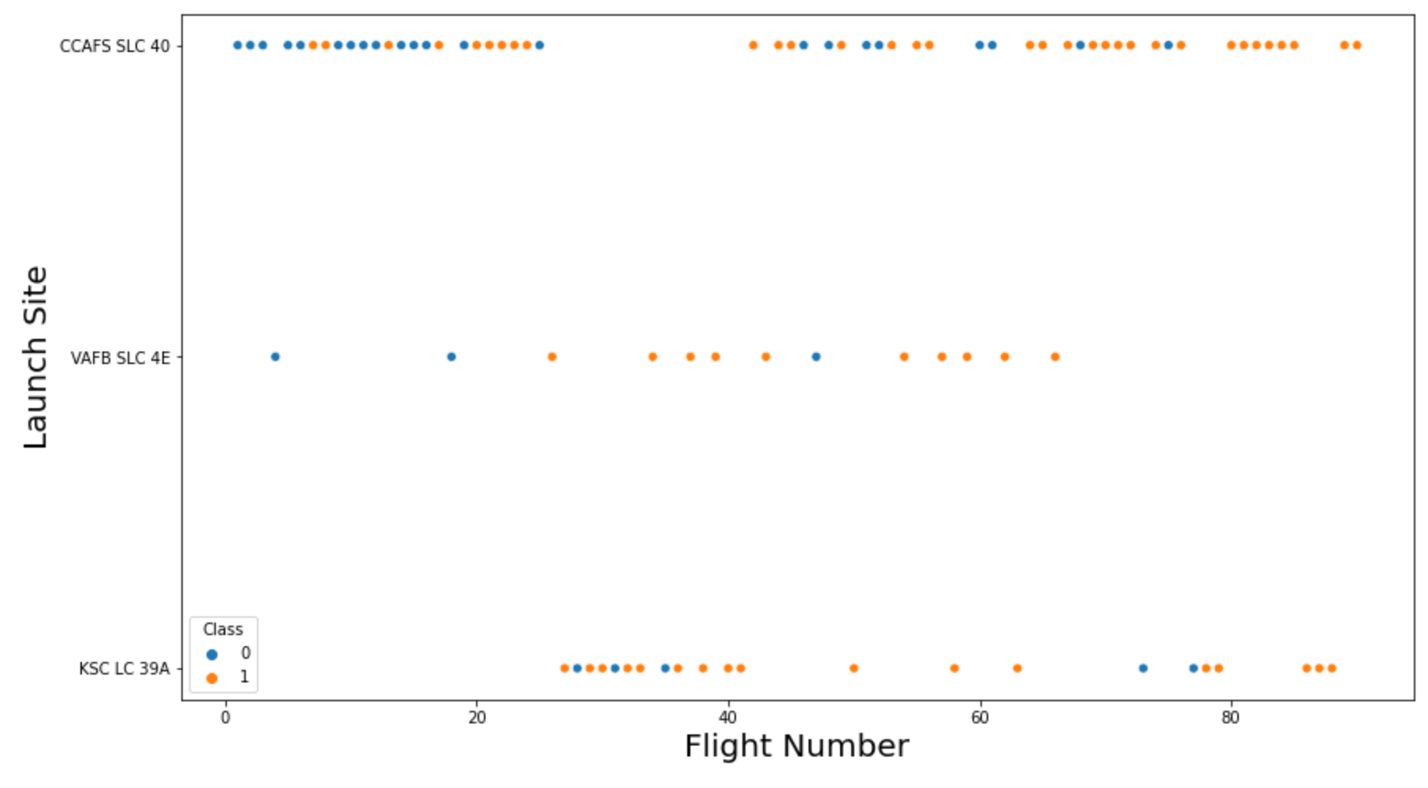
Flight Number vs. Launch Site

Slide 21
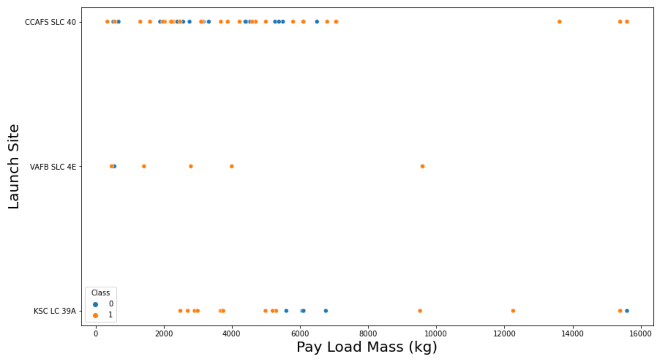
Payload vs. Launch Site

Slide 22
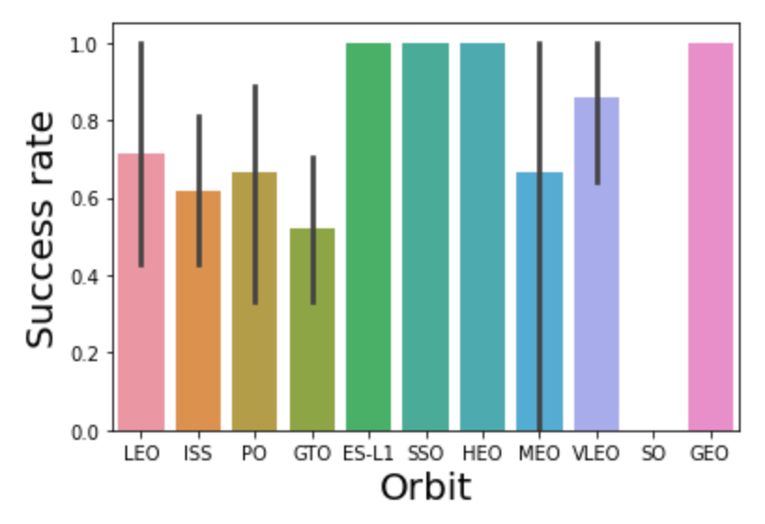
Success Rate vs. Orbit Type

Slide 23
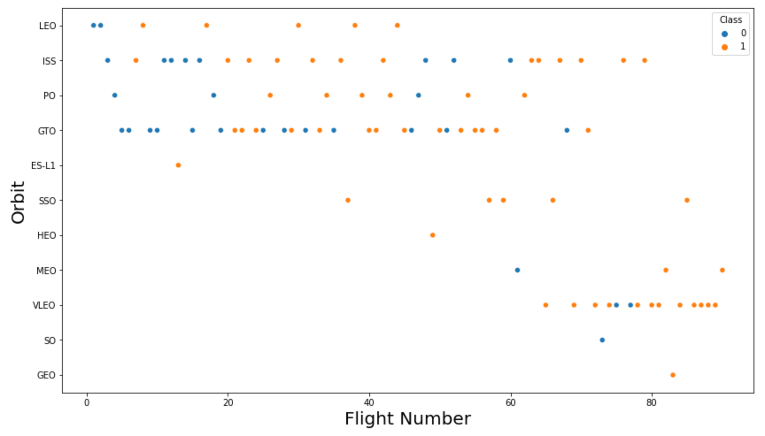
Flight Number vs. Orbit Type

Slide 24
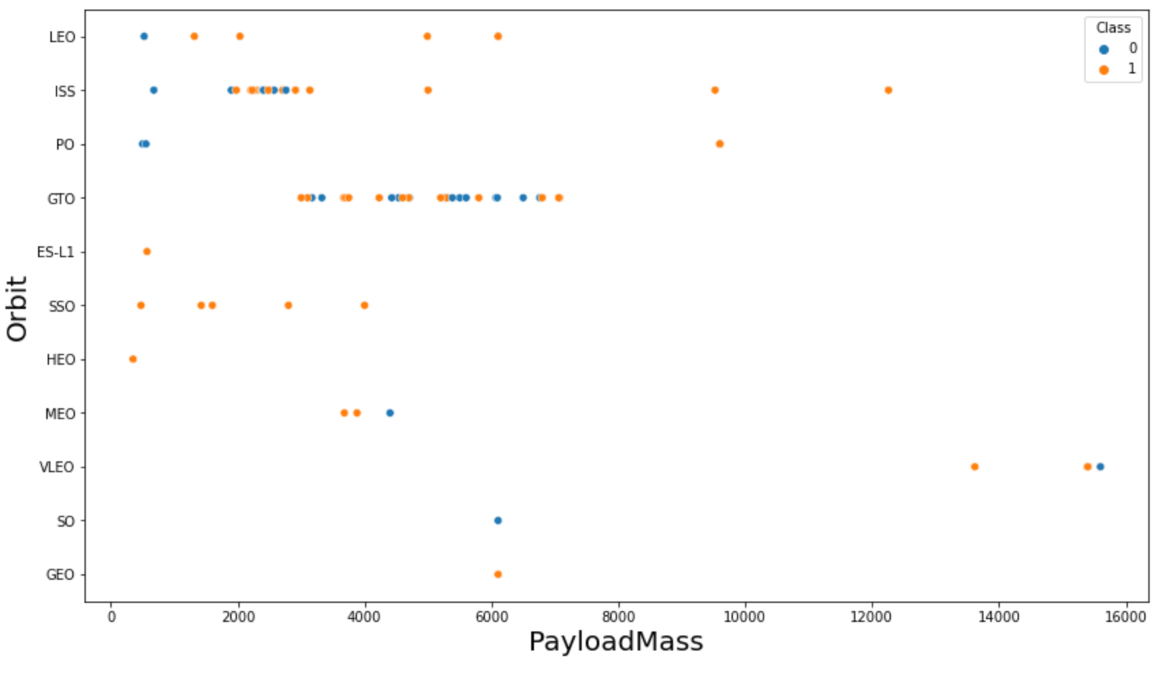
Payload vs. Orbit Type

Slide 25
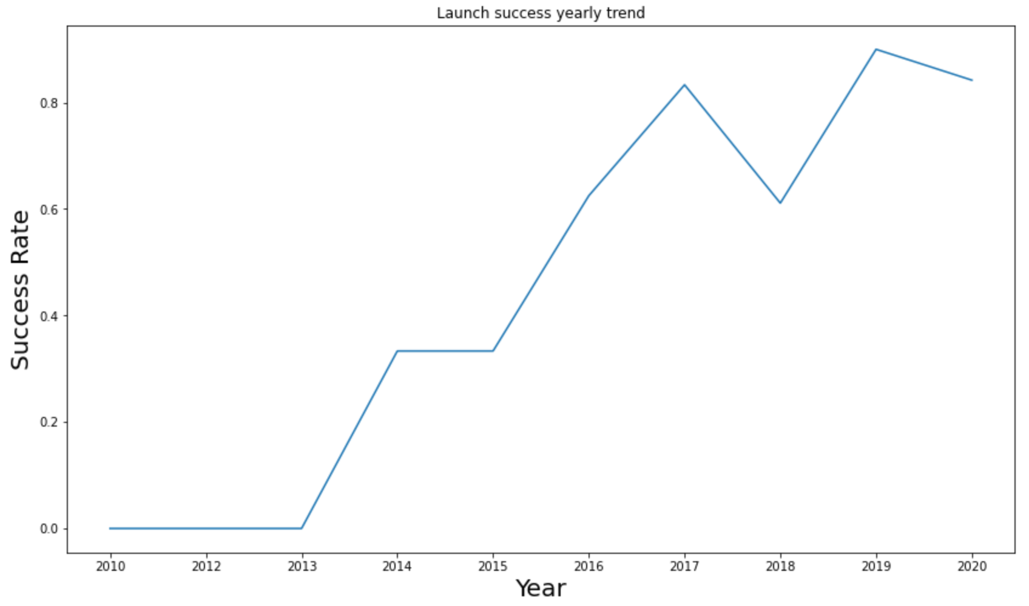
Launch Success Yearly Trend

Slide 26
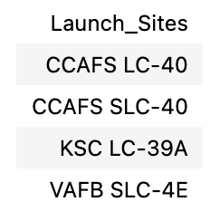
All Launch Site Names

Slide 27
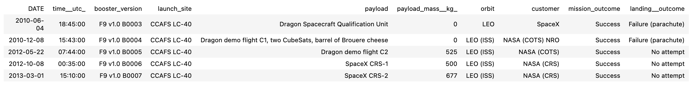
Launch Site Names Begin with 'CCA'

Slide 28
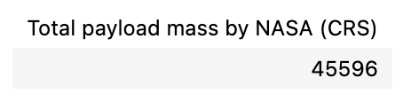
Total Payload Mass

Slide 29
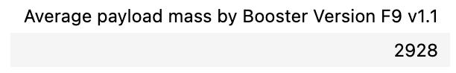
Average Payload Mass by F9 v1.1

Slide 30
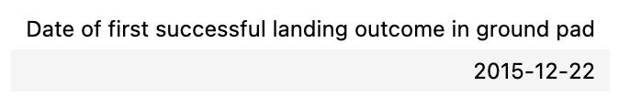
First Successful Ground Landing Date

Slide 31
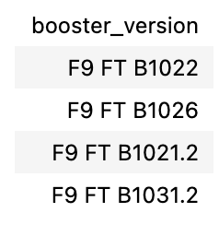
Successful Drone Ship Landing with Payload between 4000 and 6000

Slide 32
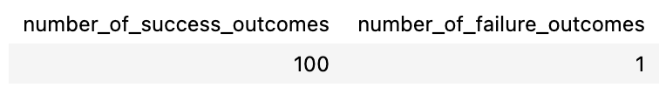
Total Number of Successful and Failure Mission Outcomes

Slide 33
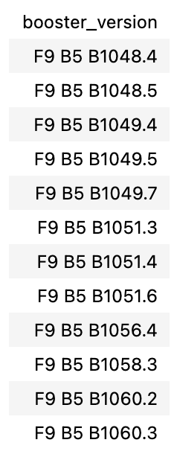
Boosters Carried Maximum Payload

Slide 34
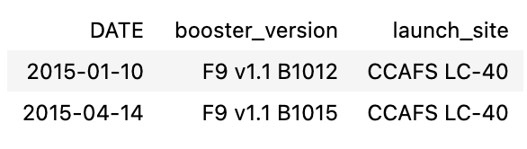
2015 Launch Records
The failed landing outcomes in drone ship, their booster versions, and launch site names for in year 2015

Slide 35
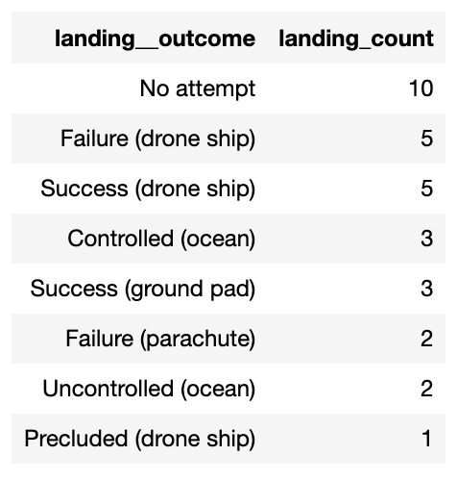
Rank Landing Outcomes Between 2010-06-04 and 2017-03-20
The count of landing outcomes between the date 2010-06-04 and 2017-03-20, in descending order

Slide 36

Section 3

Slide 37
<All launch sites on map>

Slide 38
Folium Results

Slide 39
Results Folium
The distances between a launch site to its proximities such as the nearest city, railway, or highway
The picture below shows the distance between the VAFB SLC-4E launch site and the nearest coastline

Slide 40

Section 4

Slide 41

<Dashboard Screenshot 1>
The picture below shows a pie chart when launch site CCAFS LC-40 is chosen.
0 represents failed launches while 1 represents successful launches. We can see that 73.1% of launches done at CCAFS LC-40 are failed launches.

Slide 42
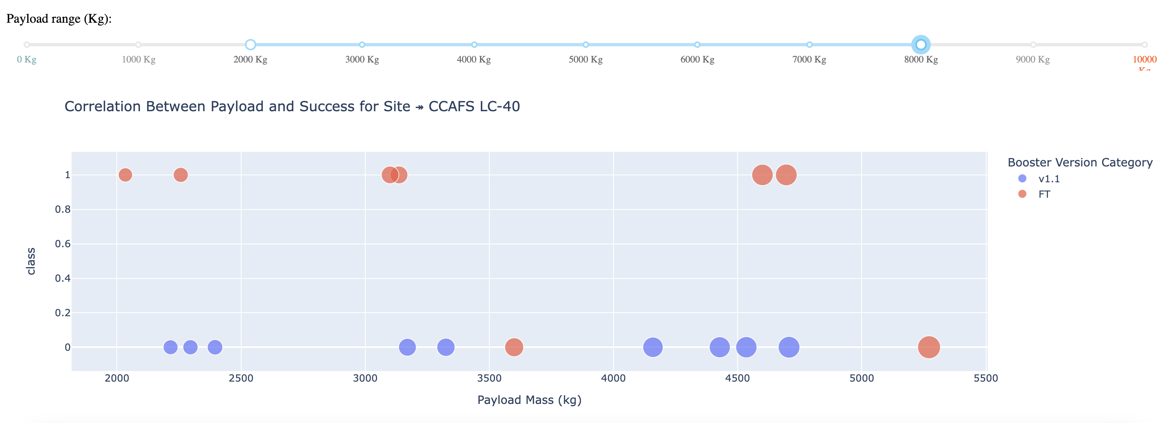
Dashboard
The picture below shows a pie chart when launch site CCAFS LC-40 is chosen.
0 represents failed launches while 1 represents successful launches. We can see that 73.1% of launches done at CCAFS LC-40 are failed launches.etc.

Slide 43

Section 5

Slide 44
Classification Accuracy
Logistic regression
GridSearchCV best score: 0.8464285714285713
Accuracy score on test set: 0.8333333333333334

Slide 45

Confusion Matrix

Slide 46
Conclusions
Model Comparison and Ranking
When evaluated on the test dataset, all four machine learning models produced identical accuracy scores and confusion matrices, making it difficult to differentiate their performance based solely on test set results.
To address this, we used the best cross-validation scores from GridSearchCV as a more reliable metric for model comparison. Based on these scores, the models are ranked as follows (from best to worst):
Decision Tree – Best score: 0.889
K-Nearest Neighbors (KNN) – Best score: 0.848
Support Vector Machine (SVM) – Best score: 0.848
Logistic Regression – Best score: 0.846
This ranking suggests that the Decision Tree classifier outperformed the others during cross-validation and is therefore considered the most promising model for predicting Falcon 9 landing success.

Slide 47
Appendix
Include any relevant assets like Python code snippets, SQL queries, charts, Notebook outputs, or data sets that you may have created during this project

Slide 48


